Slide 1


DATA PRESENTATION
PRESENTED BY:
NAME
ROLE
CONTACT INFORMATION

Slide 2

1 | Engage Objectives
2 | Strategic Plan
3 | Number of Trainees
4 | Demographics of trainees
5 | Evaluation Results
6 | Moving Forward
AGENDA

Slide 3

OBJECTIVES
Help to foster a culture of awareness, care, and inclusion
GOALS :
  Give students the skills and confidence to respond to various problems and concerns students may encounter while in college including alcohol & other drugs, bias & discrimination, interpersonal violence, and mental well-being and suicide
  Reduce risk factors and promote protective factors such as community support and connection & commitment to the school.

Slide 4
STRATEGIC PLAN
GOAL 1
GOAL 1, STRATEGY 1
GOAL 1, STRATEGY 2
GOAL 1, STRATEGY 3

Slide 5
STRATEGIC PLAN
GOAL 2
GOAL 2, STRATEGY 1
GOAL 2, STRATEGY 1
GOAL 2, STRATEGY 1

Slide 6
IMPLEMENTATION TEAM
NAME
NAME
NAME
ROLE
ROLE
ROLE
NAME
NAME
NAME
ROLE
ROLE
ROLE

Slide 7




Number of Trainees
DATA
Number, demographics, affiliation
All the data.
Results from PIP
Pre and Post Test Evaluations from PIP
Campus Evaluation

Slide 8
TIMEFRAME
Number of Trainees
400
Semester | Number of Trainees
Fall 20XX
Spring 20XX
TOTAL
300
200
100
0
Fall 20XX
Spring 20XX

Slide 9
DEMOGRAPHICS
 | Fall 20XX | Spring 20XX
DEMOGRAPHIC
DEMOGRAPHIC
DEMOGRAPHIC

Slide 10
ROLE/CLASS STANDING

Slide 11
GENDER IDENTITY

Slide 12
FRATERNITY & SORORITY LIFE

Slide 13
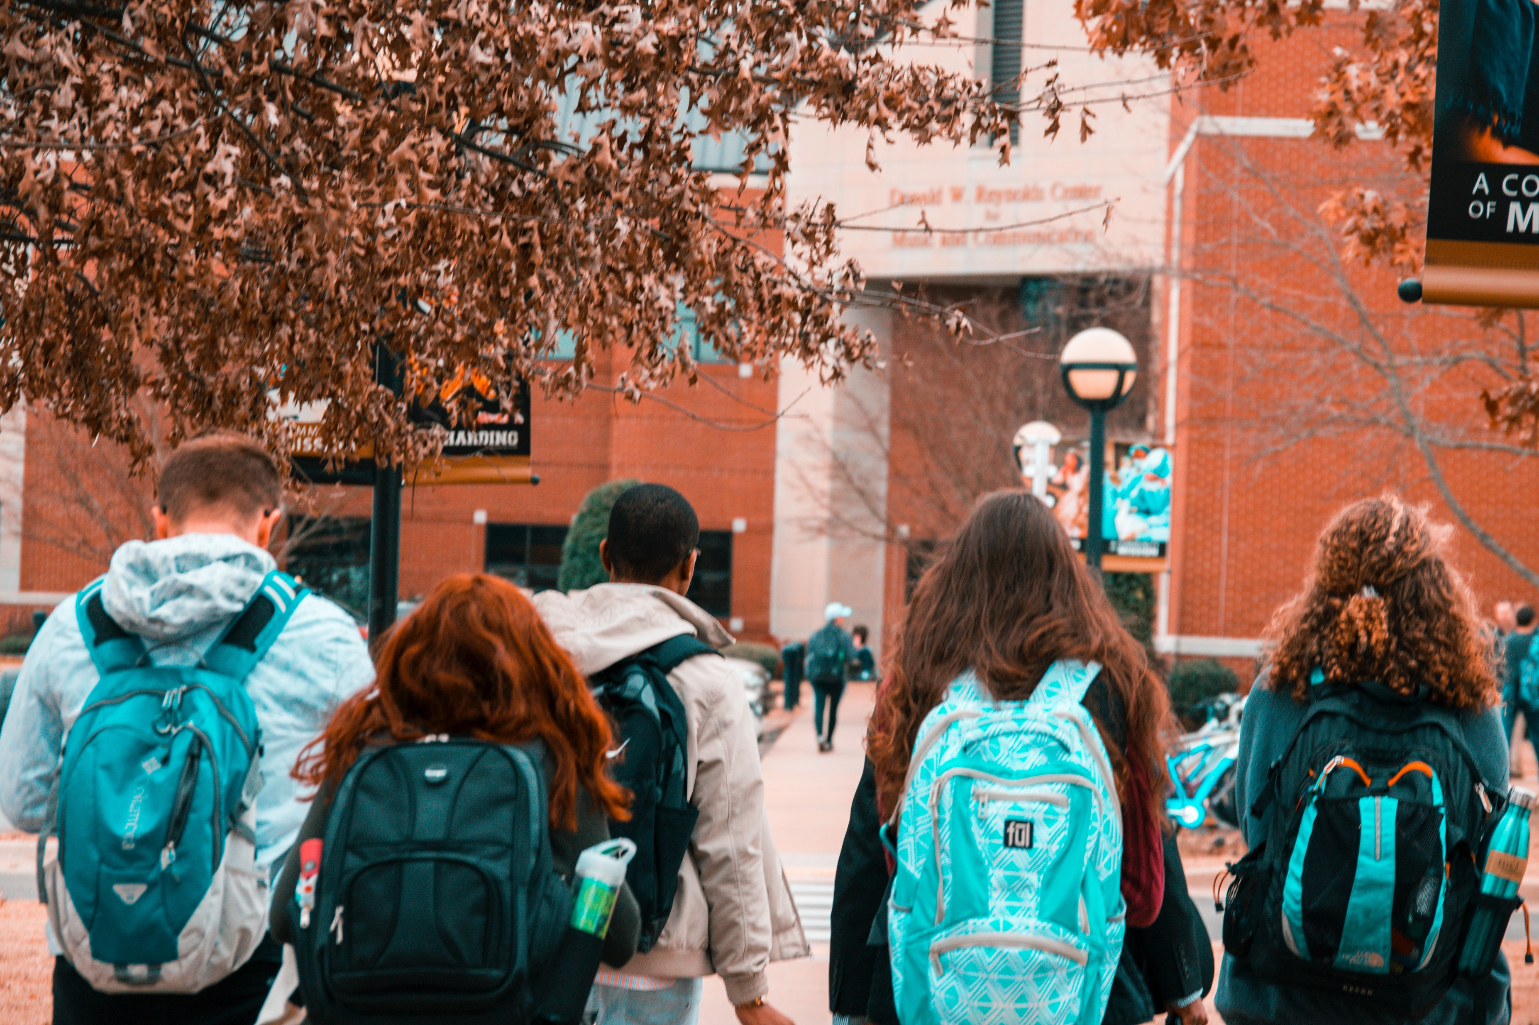
EVALUATION
summary

Slide 14
PRE-TEST ONLY
Percentage of students who agree or strongly agree with the statement.
%
%
I believe I should make a difference at my campus and in my community.
I feel a sense of belonging to the campus community.
I believe I have a responsibility to contribute to the safety and well-being of other students.
Involvement in campus and or community causes is important to me.
%
%

Slide 15
SKILLS
I feel I have the skills to do something in a situation where someone is hurt or at risk of being harmed.

Slide 16
INTERVENION BASED ON RELATIONSHIP TO STUDENT
I would do something in a situation where a __________________
was being harmed.

Slide 17
TYPES OF HARMFUL SITUATIONS
Please indicate if you would feel comfortable and able to intervene in situations of...

Slide 18
ADDITIONAL EVALUATION

Slide 19
OPEN TEXT FEEDBACK
“Insert open text feedback here”
“Insert open text feedback here”
“Insert open text feedback here”
“Insert open text feedback here”
“Insert open text feedback here”

Slide 20
OPPORTUNITIES FOR GROWTH
TOPIC | TOPIC | TOPIC
FEEDBACK/STRATEGY | FEEDBACK/STRATEGY | FEEDBACK/STRATEGY

Slide 21

MOVING FORWARD
TIMELINE
Summer 20XX
Fall 20XX
Spring 20XX
Summer 20XX
PLAN
PLAN
PLAN
PLAN

Slide 22
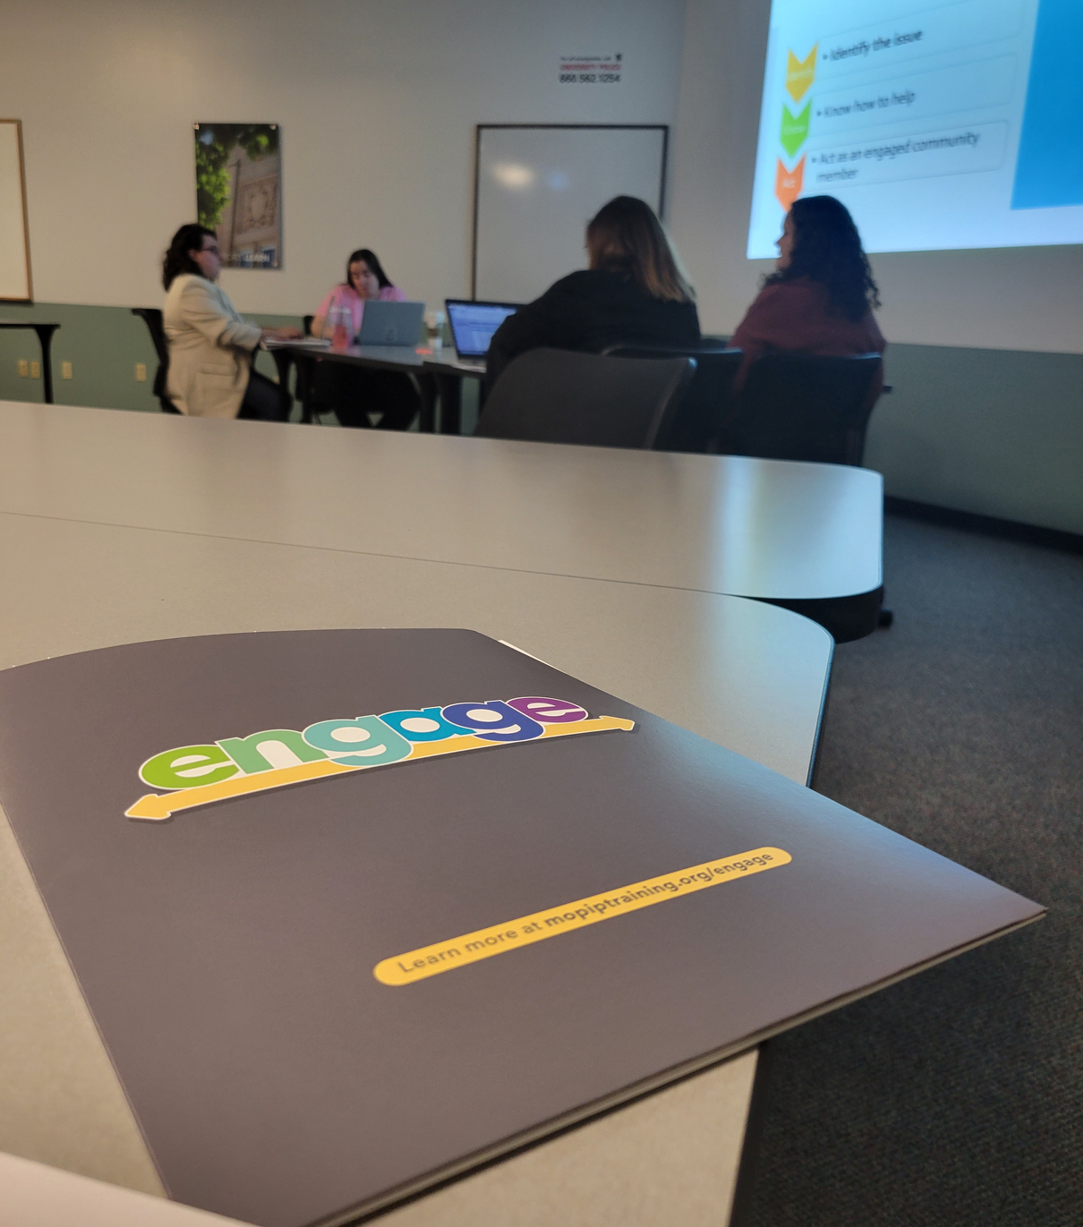
FINAL THOUGHTS

Slide 23
THANK YOU FOR YOUR SUPPORT!

